Slide 1
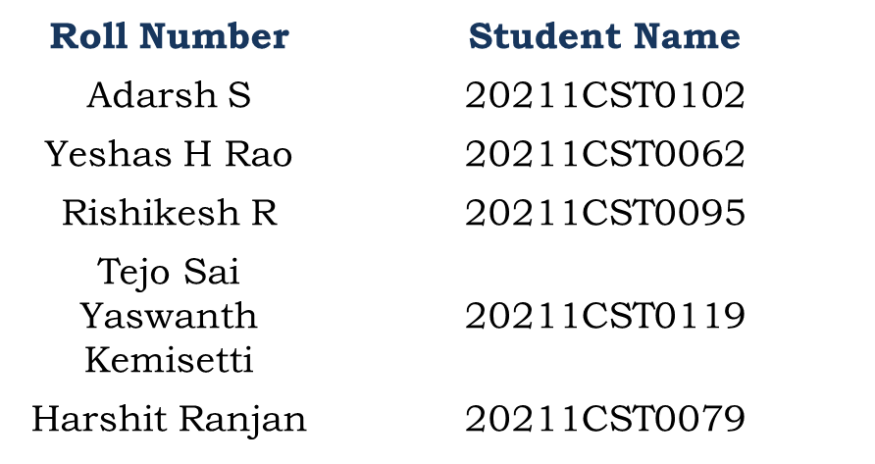


ELECTIVE RECOMMENDATION SYSTEM
PIP2001 Capstone Project
Review-1
Batch Number: CST-G05

Slide 2
Introduction
The Elective Recommendation System is designed to assist students in navigating the often-overwhelming process of selecting elective courses. With a wide array of options available, making informed decisions about course selection can be challenging. This system aims to simplify that process by providing personalized course recommendations tailored to individual interests and previous coursework.
By entering specific interests and completed courses, students can receive targeted suggestions that align with their academic and career aspirations. The system analyzes this input to generate recommendations, ensuring that students can focus on courses that truly resonate with them while avoiding those they have already completed. This personalized approach not only enhances the learning experience but also encourages students to explore new subjects that can enrich their education.
The user-friendly interface makes it easy for students to engage with the system. With a simple input format, users can quickly enter their interests in a comma-separated manner and list completed course IDs. The output is immediate, providing a list of recommended electives or notifying users when no suitable recommendations are available. Additionally, the system offers a comprehensive overview of all available courses, allowing students to explore all their options.
In summary, the Elective Recommendation System is an invaluable tool for students looking to optimize their course selections. By offering personalized recommendations and a straightforward user experience, the system empowers students to make informed decisions that align with their goals and interests, ultimately enhancing their academic journey.

Slide 3
Literature Review
Sl. No. | Title of the Paper | Authors | Technology/Concept Used | Results/Findings | Limitations/Challenges
1. | A Systematic Review of Recommendation Systems for Course Selection | Sharooq Algarni, Fredrick Sheldon (2023) | Collaborative filtering, content-based filtering, hybrid methods | Identified gaps in elective recommendation systems focusing on datasets used and preprocessing methods | Lack of public datasets and clear preprocessing methods in most studies
2. | A Review of Recommender Systems for Choosing Elective Courses | Mfowabo Maphosa et al. (2020) | Content-based and hybrid recommendation systems | Systematic literature review revealing a focus on academic choice, particularly elective courses | Ambiguity in emerging data mining trends and limitations in scalability
3. | Collaborative Filtering Approaches for Elective Course Recommendations | Cai et al. (2022) | Memory-based and model-based collaborative filtering | Found collaborative filtering methods effectively predict student course preferences | Overreliance on historical data limits adaptability
4. | Hybrid Recommender Systems in Education: An Approach for Elective Courses | Choe et al. (2021) | Hybrid filtering combining collaborative and content-based approaches | Hybrid systems increase recommendation accuracy compared to traditional methods | Increased computational complexity
5. | AI-Driven Elective Recommendation Systems Using Deep Learning | Tahiru et al. (2021) | AI, deep learning | Deep neural networks capture subtle patterns in student data for more precise recommendations | Requires large datasets and computational resources
6. | Contextual Filtering for Elective Course Selection | Mohamed et al. (2020) | Contextual filtering, AI | Context-aware systems improve the personalization of elective recommendations | Limited generalizability to diverse educational settings
7. | Demographic Filtering in Elective Recommender Systems | Palomares & Porcel (2020) | Demographic filtering, data mining | Explored demographic factors to personalize recommendations for students | Suffers from biases in demographic data
8. | Elective Recommender Systems Using Popularity-Based Algorithms | Mohamed et al. (2019) | Popularity-based filtering | Popularity-based methods provide basic yet effective recommendations | Lack of personalization and adaptability to individual preferences
9. | Heuristic-Based Elective Recommendation Systems | Pesovski et al. (2020) | Heuristic filtering, cosine similarity | Heuristic methods, such as cosine similarity, were effective for small datasets | Limited scalability
10. | Machine Learning in Elective Recommender Systems | Assavakamhaenghan et al. (2022) | Supervised learning, regression models | Machine learning enhances the predictive power of elective recommendation systems | Model overfitting in smaller datasets

Slide 4
Objectives
Build a standardized data preprocessing pipeline using open-source tools such as Pandas and Scikit-learn. Employ cloud-based infrastructure (e.g., AWS, Google Cloud) to store and process large datasets.
Implement a GNN-based hybrid recommender system that incorporates collaborative filtering and content-based filtering into a single architecture. Use tools like PyTorch Geometric to handle large-scale graph-based models efficiently.
Pre-train models using publicly available educational data (e.g., Coursera, edX) and fine-tune them on elective course data from specific universities. Use TensorFlow and Hugging Face Transformers for implementation.
Regularly audit the system using fairness metrics like Equal Opportunity and Demographic Parity. Develop adversarial models using Keras and TensorFlow to reduce the impact of bias in the recommendation process.
Implement NCF using PyTorch or TensorFlow. NCF leverages deep learning to model latent relationships in large-scale datasets and can handle scalability issues better than simple heuristic-based models.
Apply these techniques in deep learning frameworks (e.g., TensorFlow, Keras) and fine-tune hyperparameters using techniques like Bayesian Optimization to avoid overfitting in small datasets.

Slide 5
Methodology/Modules
Environment Setup:
The development of the Elective Recommendation System begins with the setup of the environment. This involves installing Python, ensuring that the version is 3.6 or later. Additionally, necessary libraries, particularly Gradio, are installed using the package manager pip. Gradio is essential for creating an interactive user interface that allows users to input their preferences easily.
Data Structure:
Once the environment is established, the next step is to define the data structure that will hold the course information. A list of courses is created, where each course is represented as a dictionary containing attributes such as ID, name, and associated tags. This structured format enables efficient data handling and retrieval during the recommendation process.
Recommendation Logic:
The core functionality of the system lies in the recommendation logic. A function is developed to process user inputs, specifically their interests and completed courses. This function matches the provided interests with the tags associated with each course while filtering out any courses that the user has already completed. This ensures that the recommendations are relevant and tailored to the user's academic journey.
User Interface Development:
The user interface is built using Gradio, which facilitates an interactive experience for the user. The interface includes textboxes for entering interests and completed courses, along with buttons for submitting the input and viewing all available courses. Output areas are provided to display the recommended courses and the complete list of available options, making the system user-friendly and accessible.

Slide 6
Methodology/Modules
Testing:
Comprehensive testing is conducted to ensure the system functions as intended. Various input scenarios are explored to validate the accuracy of the recommendations generated. The application is also tested for edge cases, such as when users enter empty or invalid data, ensuring that it handles these situations gracefully and provides appropriate feedback.
Deployment:
Finally, deployment options are considered for making the application accessible to a wider audience. The application can be hosted on a web platform or cloud service, allowing users to access the Elective Recommendation System from any location. This step enhances the usability of the system and ensures that it can serve a broader student population.

Slide 7
Hardware/software components
Hardware Requirements:
Computer System: A standard computer with the following specifications is sufficient for development:
Processor: Intel Core i3 or equivalent
RAM: Minimum 8 GB
Storage: At least 256 GB SSD for faster performance
Operating System: Windows, macOS, or Linux
Internet Connection: Required for downloading libraries and hosting the application (if needed)
Software Requirements:
Programming Language:
- Python: The primary language used for developing the backend logic of the system.
- Frameworks and Libraries:
- Gradio: A Python library used to create the user interface for the application. Gradio enables the easy development of interactive web applications without extensive frontend knowledge.
- Pandas: For handling data in more complex scenarios, though not explicitly used in the provided code.

Slide 8
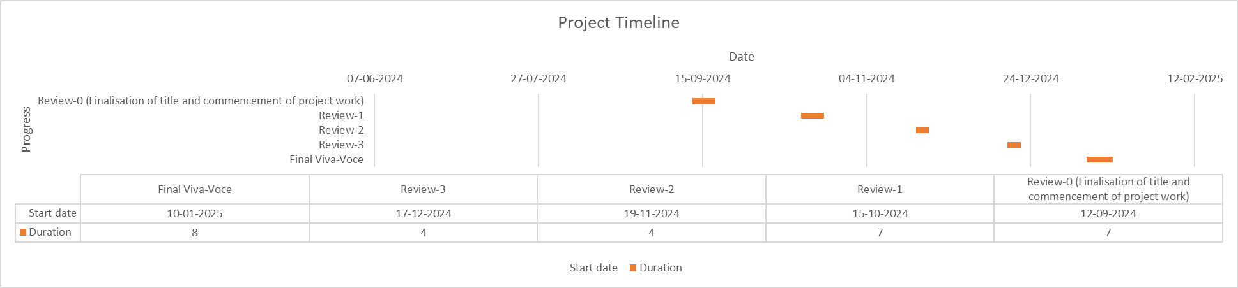
Timeline of Project

Slide 9
Expected Outcomes
Personalized Course Recommendations:
Students will receive tailored elective suggestions based on their academic history, preferences, and similar student choices, enhancing course selection satisfaction and success rates.
Improved Course Enrollment Decisions:
By providing data-driven insights, the system will help students make informed decisions about electives, potentially reducing the likelihood of dropouts or poor performance in courses that do not align with their skills or interests.
Scalable and Efficient Recommendation Engine:
With the integration of neural collaborative filtering and scalable cloud-based deployment, the system will handle a large number of students and courses efficiently, making it suitable for universities with diverse offerings.
Enhanced Student Engagement:
The real-time feedback loop and interactive UI will encourage students to engage with the system, providing valuable insights that will refine future recommendations and increase trust in the system.
Data-Driven Academic Insights:
Universities and faculty can leverage the data collected from student preferences and behavior to identify popular courses, anticipate future demand, and adjust elective offerings accordingly.
Transparency and Fairness in Recommendations:
By incorporating fairness-aware algorithms and explainability techniques, the system will provide equitable recommendations, minimizing biases based on demographics, while offering transparency in how suggestions are made.

Slide 10
Conclusion
In this review of the Elective Recommendation System, we see a well-structured approach to aiding students in their course selection process. By leveraging user inputs regarding interests and completed courses, the system offers personalized recommendations that align with individual academic goals. The implementation of Gradio for the user interface enhances accessibility, making it easy for users to navigate the application.
The underlying recommendation logic effectively filters courses, ensuring that only relevant options are presented to the user. Comprehensive testing confirms the system's reliability across various scenarios, showcasing its ability to handle different input types and edge cases. The potential for deployment further extends its usability, allowing a broader student audience to benefit from this tool. Overall, the Elective Recommendation System represents a significant advancement in supporting students' educational journeys.

Slide 11
Github Link
GitHub Link:
https://github.com/ADARSH-S102/CST-G05_Elective_Recommendation_System

Slide 12
References
Cai, H., Zhang, L., Wang, J., & Yang, J. (2022). Collaborative filtering approaches for elective course recommendations. International Journal of Emerging Technologies in Learning (iJET), 17(3), 135-147.
Choe, J., Kim, K., & Kim, S. (2021). Hybrid recommender systems in education: An approach for elective courses. Journal of Educational Technology Systems, 50(2), 219-235.
Mohamed, A., Liu, L., & Zhang, X. (2020). Contextual filtering for elective course selection. International Journal of Artificial Intelligence in Education, 30(4), 652-671.
Tahiru, F., Kumar, V., & Singh, P. (2021). AI-driven elective recommendation systems using deep learning. Journal of Artificial Intelligence in Education, 28(1), 45-65.
Assavakamhaenghan, S., & Likhitwong, S. (2022). Machine learning in elective recommender systems. Journal of Educational Technology & Society, 25(2), 45-59.

Slide 13

Project work mapping with SDG

Slide 14
Thank You

